Slide 1
DECISION TREE ALGORITHM
By
J.AKHILA

Slide 2
Decision TREE ALGORITHM
Decision tree algorithm falls under the category of supervised learning. They can be used to solve both regression and classification problems.
Decision tree uses the tree representation to solve the problem in which each leaf node corresponds to a class label and attributes are represented on the internal node of the tree.
The decisions or the test are performed on the basis of features of the given dataset.
It is called a decision tree because, similar to a tree, it starts with the root node, which expands on further branches and constructs a tree-like structure.

Slide 3

Decision TREE ALGORITHM

Slide 4
Decision TREE ALGORITHM
Decsision tree can solve both Regression and Classification Problems
Feature Selection in Decision Tree is done through different measures according to the problem statement whether classification or regression and algorithm we use.
There are two types of Decision Trees
Decision Tree Classifier
Decision Tree Regressor

Slide 5
Decision TREE CLASSIFIER
Decision Tree Classifier:
There are majorly 2 Algorithms in Classifier
ID3: Iterative Dichometizer Which means it iteratively divides the divides the features.
In this Algorithm the features are selected according to the purity of the feature
We calculate the purity thorugh Entropy
Entropy = E=−∑i=1Npilog2pi
The least value of entopy could be 0 which means pure split and 1 being the very impure spilt.

Slide 6
Decision Tree CLASSIFIER
The 2nd Algorithm is CART
CART: Classification and Regression Trees
In CART Algorithm we calculate purity based on Gini-impurity
Gini-Impurity: G=i=1∑C​p(i)∗(1−p(i))
Gini Impurity is calculated for binary split
For Gini Impurity 0.5 being the highest value which means impure split, 0 being the lowest value which means pure split.
After Calculating Entopy and Gini-Impurity we calculate Information Gain
Information-Gain:

Slide 7
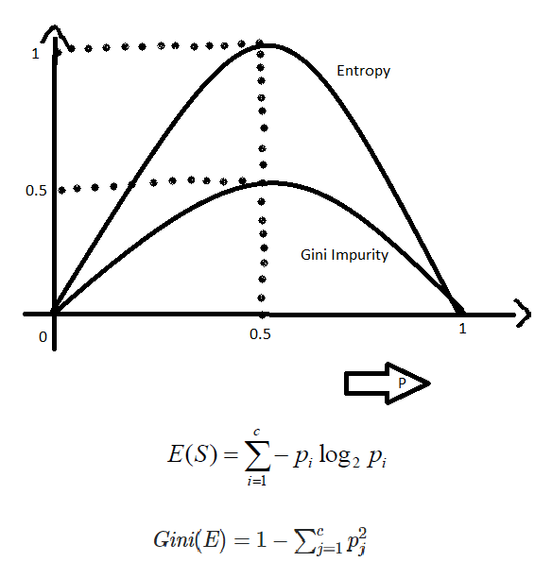
DECICION TREE CLASSIFIER
After Calculating the Information Gain
The higher the Information gain the higher the chances of the feature getting selected.
Comparing Entropy and Gini Impurity:

Slide 8

DECSION TREE REGRESSOR
For Regressor for calculating purity of the feature we use some measures like:
Mean
MSE/MAE/RMSE or Variance :
Reduction Variation : variance(root)- ∑ wi *variance[child]
If we select feature through variance(MSE) we select feature with less variance and same with reduction variation.
After Calculating the purity the same Information gain would be calculated as we did in the classifier.

Slide 9
DECISION TREE ALGORITHM
Pruning: we decide to discard some branches of the decision tree.
We perform two types of pruning they are:
Pre-pruning: While creating the decision tree we have to decide whether to cut the tree or not eg: max_depth=2,min_sample_split:2 etc.,
Post-pruning: We prune the branches after creating the whole tree for example:CCP(cost complexity pruing).

Slide 10
Decision TREE ALGORITHM
Algorithm :
Step-1: Begin the tree with the root node, says S, which contains the complete dataset.
Step-2: Find the best attribute in the dataset using Attribute Selection Measure (ASM).
Step-3: Divide the S into subsets that contains possible values for the best attributes.
Step-4: Generate the decision tree node, which contains the best attribute.
Step-5: Recursively make new decision trees using the subsets of the dataset created in step -3. Continue this process until a stage is reached where you cannot further classify the nodes and called the final node as a leaf node.

Slide 11
THANK YOU
BY
J. AKHILA

